Slide 1

Network Analysis of Ethereum Exchanges
1
MA 710 – Data Mining
Presented by
Team 4
Soubhik Chakraborty, Monika Meshram, Lalitha Voruganti, Shweta Dhakare & Prachi Vadhani

Slide 2
Introduction - Blockchain
Blockchain is a shared database that stores data in blocks connected through cryptography, differing from traditional databases in its architecture.
While blockchains can store various types of data, the most prevalent use case is as a ledger for transactions.
Decentralized blockchains are immutable, meaning that once data is entered, it cannot be altered or deleted. In the case of Bitcoin, transactions are permanently recorded and publicly visible.

Slide 3
Introduction – Anti-Money Laundering
The main goal of Anti Money Laundering (AML) efforts is to prevent criminals from concealing the profits of their unlawful activities.
Criminals use money laundering to make their illicit funds appear as though they were obtained legally.
AML regulations mandate that financial institutions establish complex customer due diligence plans that assess money laundering risks and detect suspicious transactions.

Slide 4
EDA
Observations & Variables
Size – 8GB
One Instrument – 100,000 entries & 14000 edges
20 instruments – compressing the database to 22MB

Slide 5

Purpose of Our Analysis
5
Classify groups, and segment data to search through millions of transactions to find patterns and detect fraud
Learn suspicious-looking patterns and use those patterns to detect them further through neural networks
Identify characteristics found in fraud through Pattern recognition

Slide 6
Problem Thinking
What is Fraud Detection
Why this Approach
Notes:
Monika

Slide 7
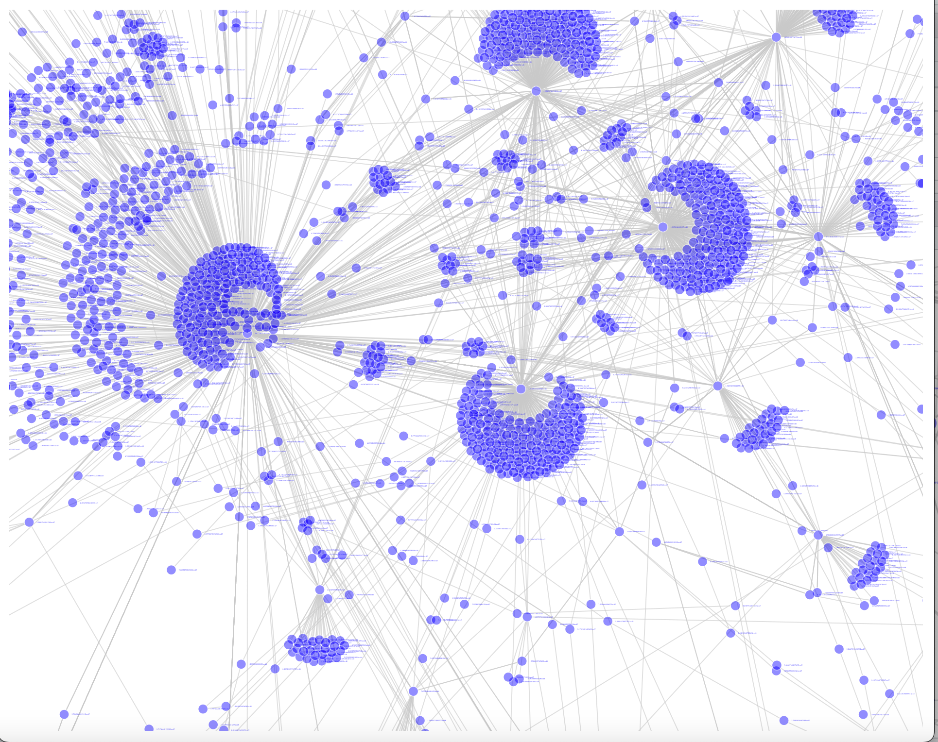
Sampling
Why sample trimming?
Approach A
largest component
Approach B
Random Sample
Notes:
Monika

Slide 8
Five Point Summary
Size
Density
Clustering coefficient
Degree distribution
Diameter
Notes:
Monica

Slide 9
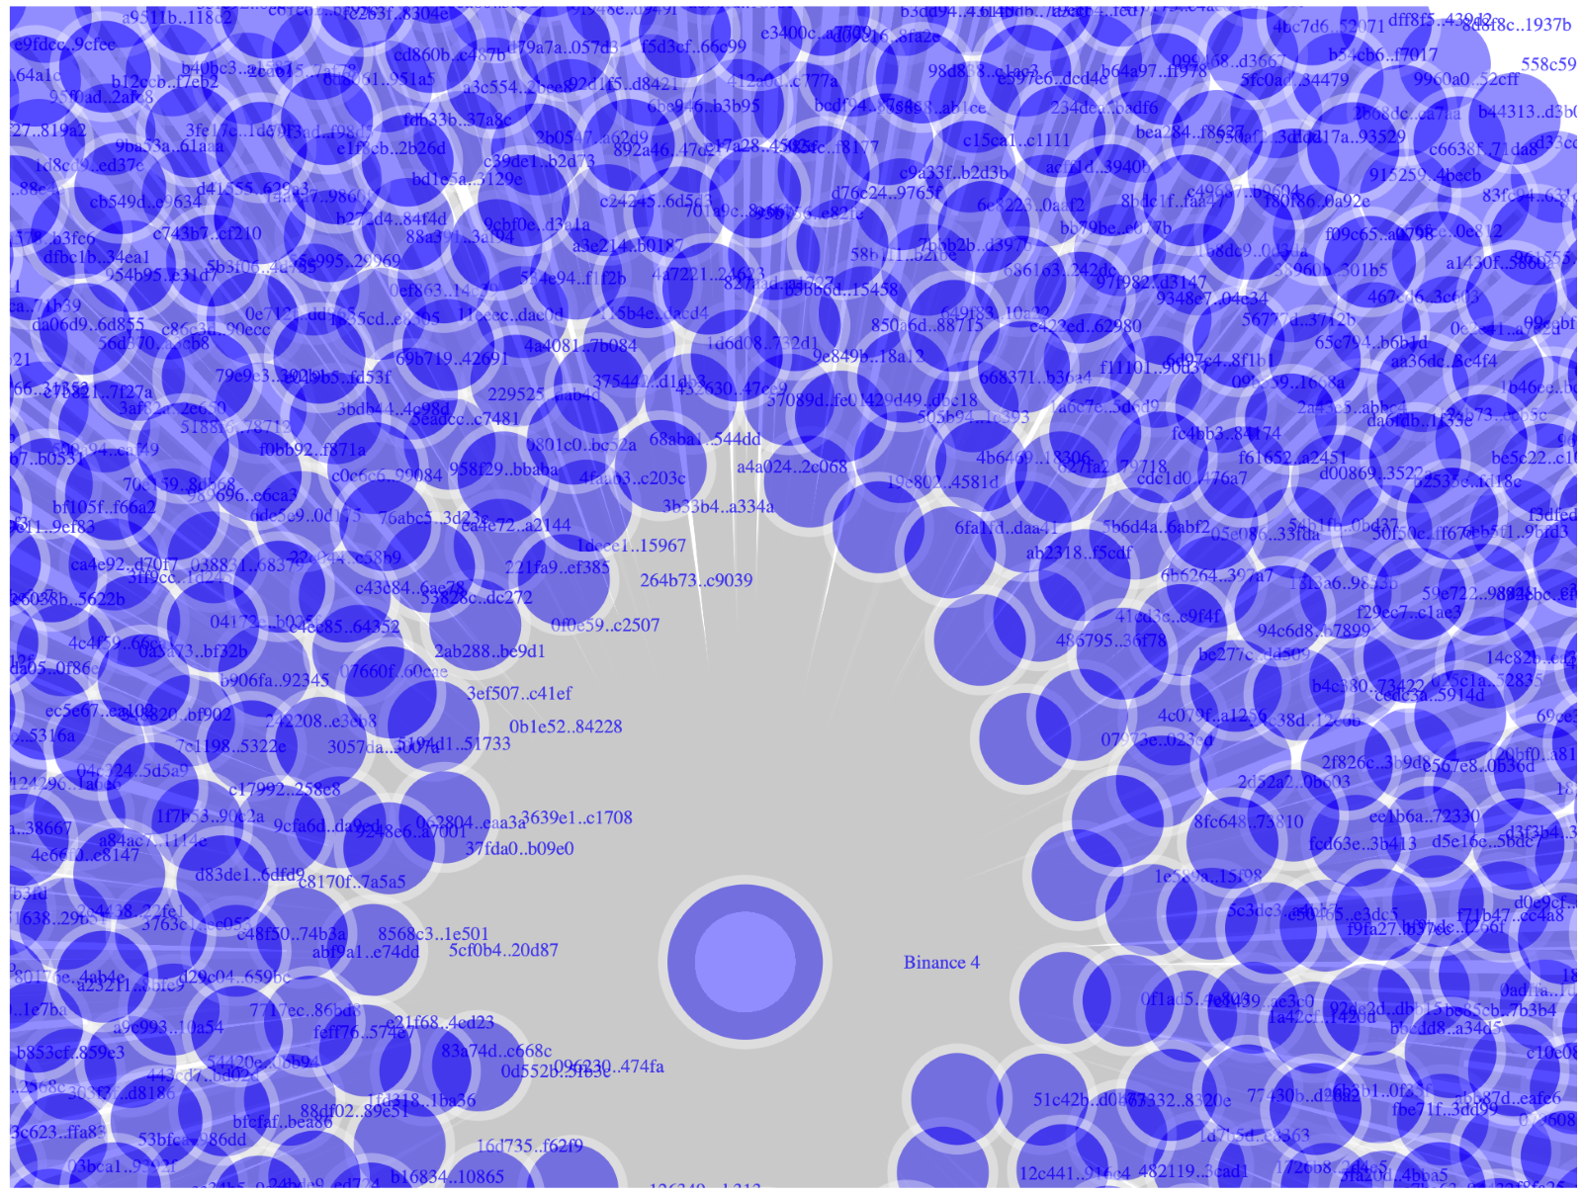
Hotspots: Binance centralized exchange (cex)
Notes:
Monica

Slide 10
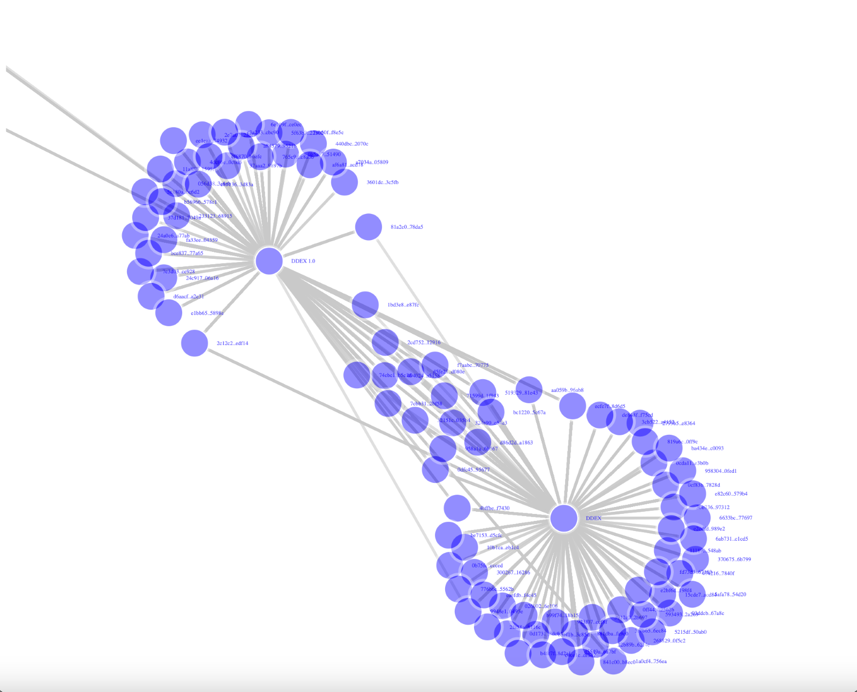
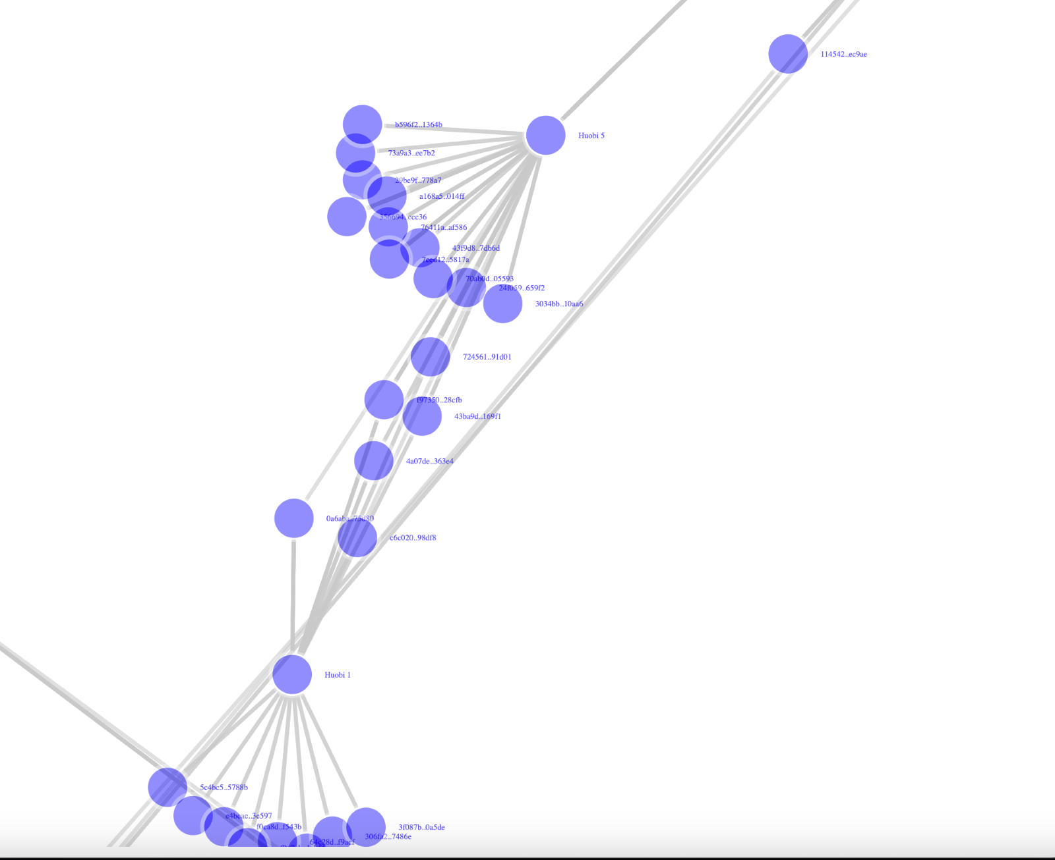
Manual Tracking of Money Laundering
Suspect Transaction
Good Transaction
Notes:
Monica

Slide 11
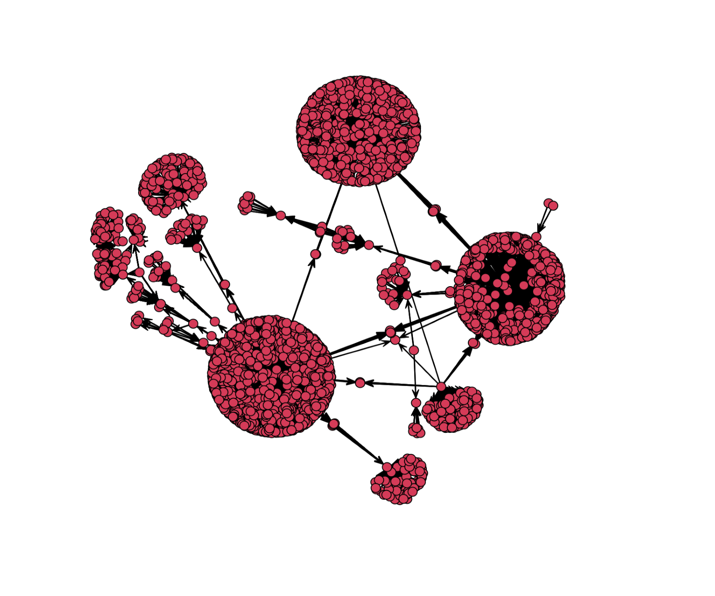
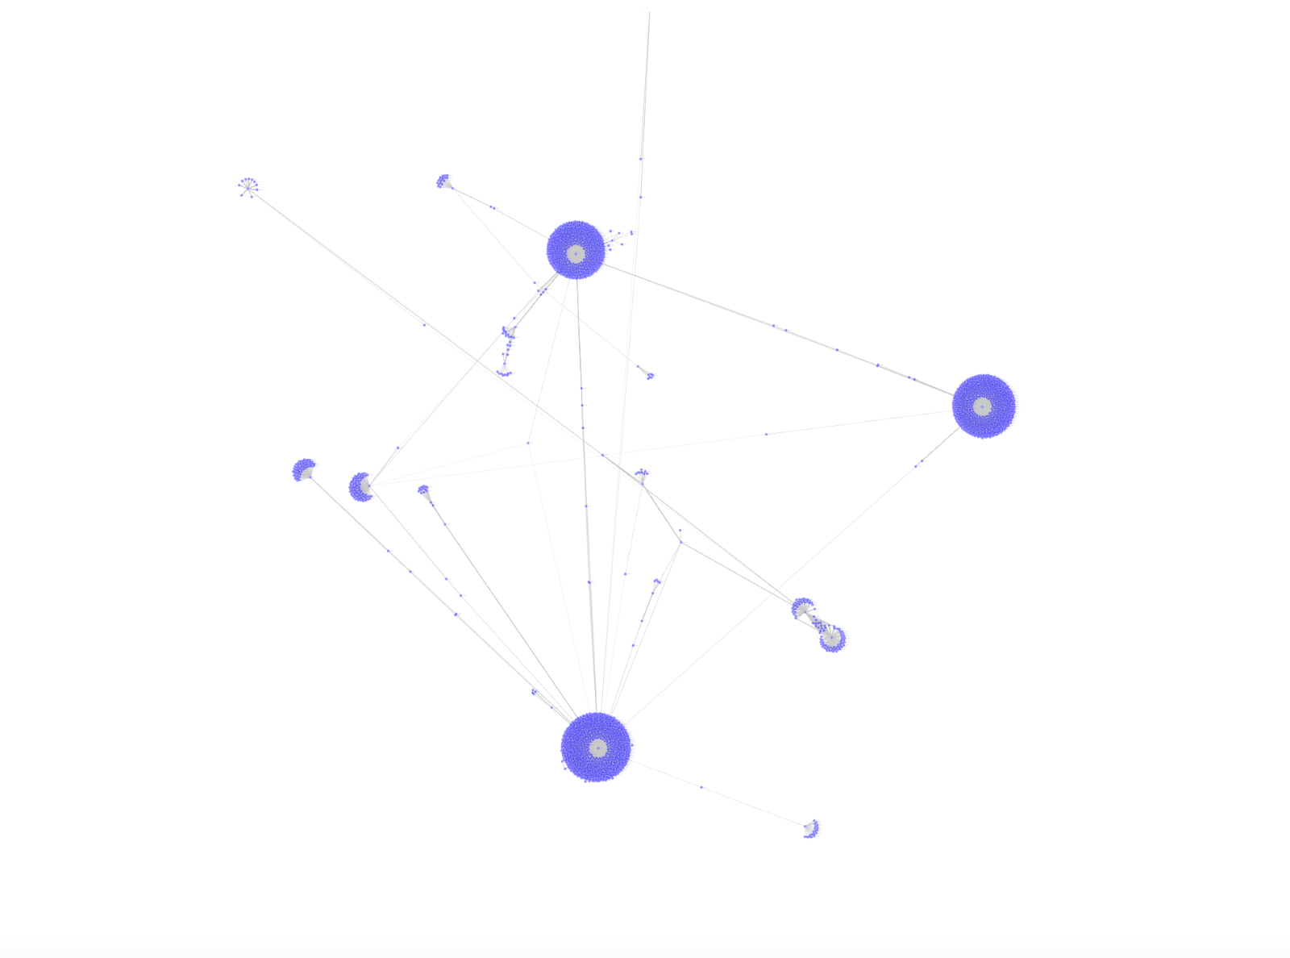
Approach A
Large Component
Notes:
Monica

Slide 12
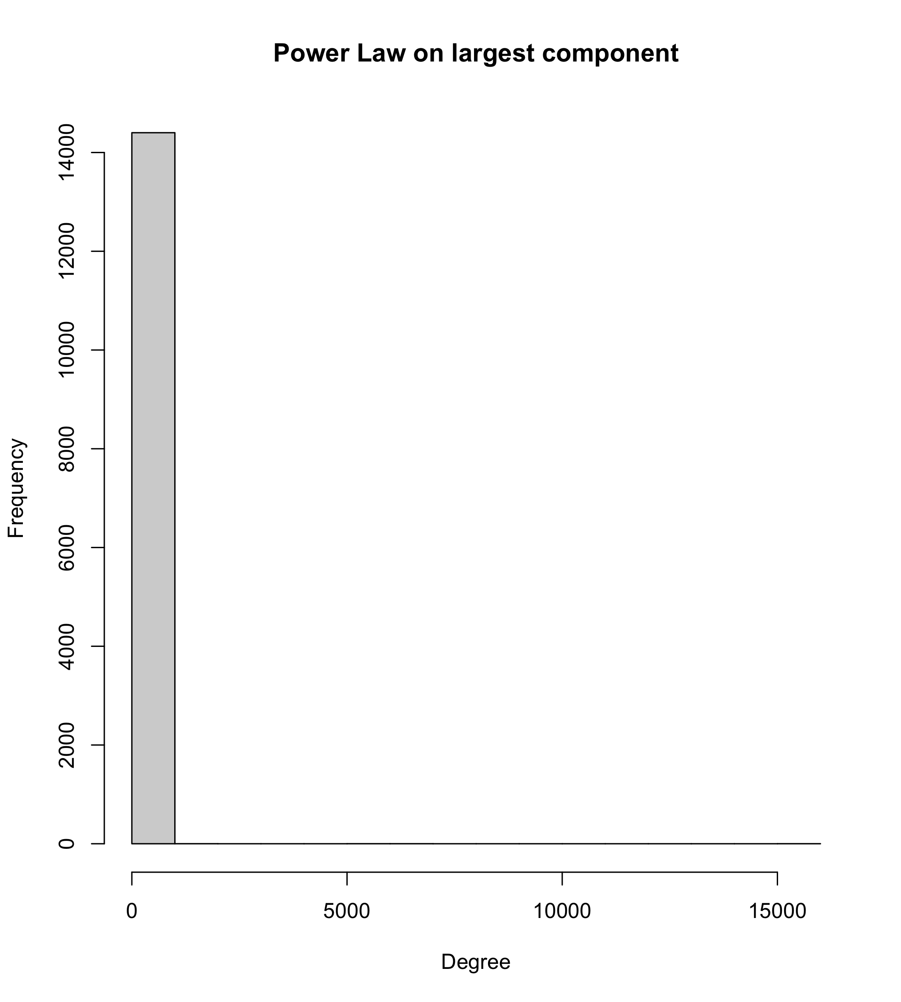
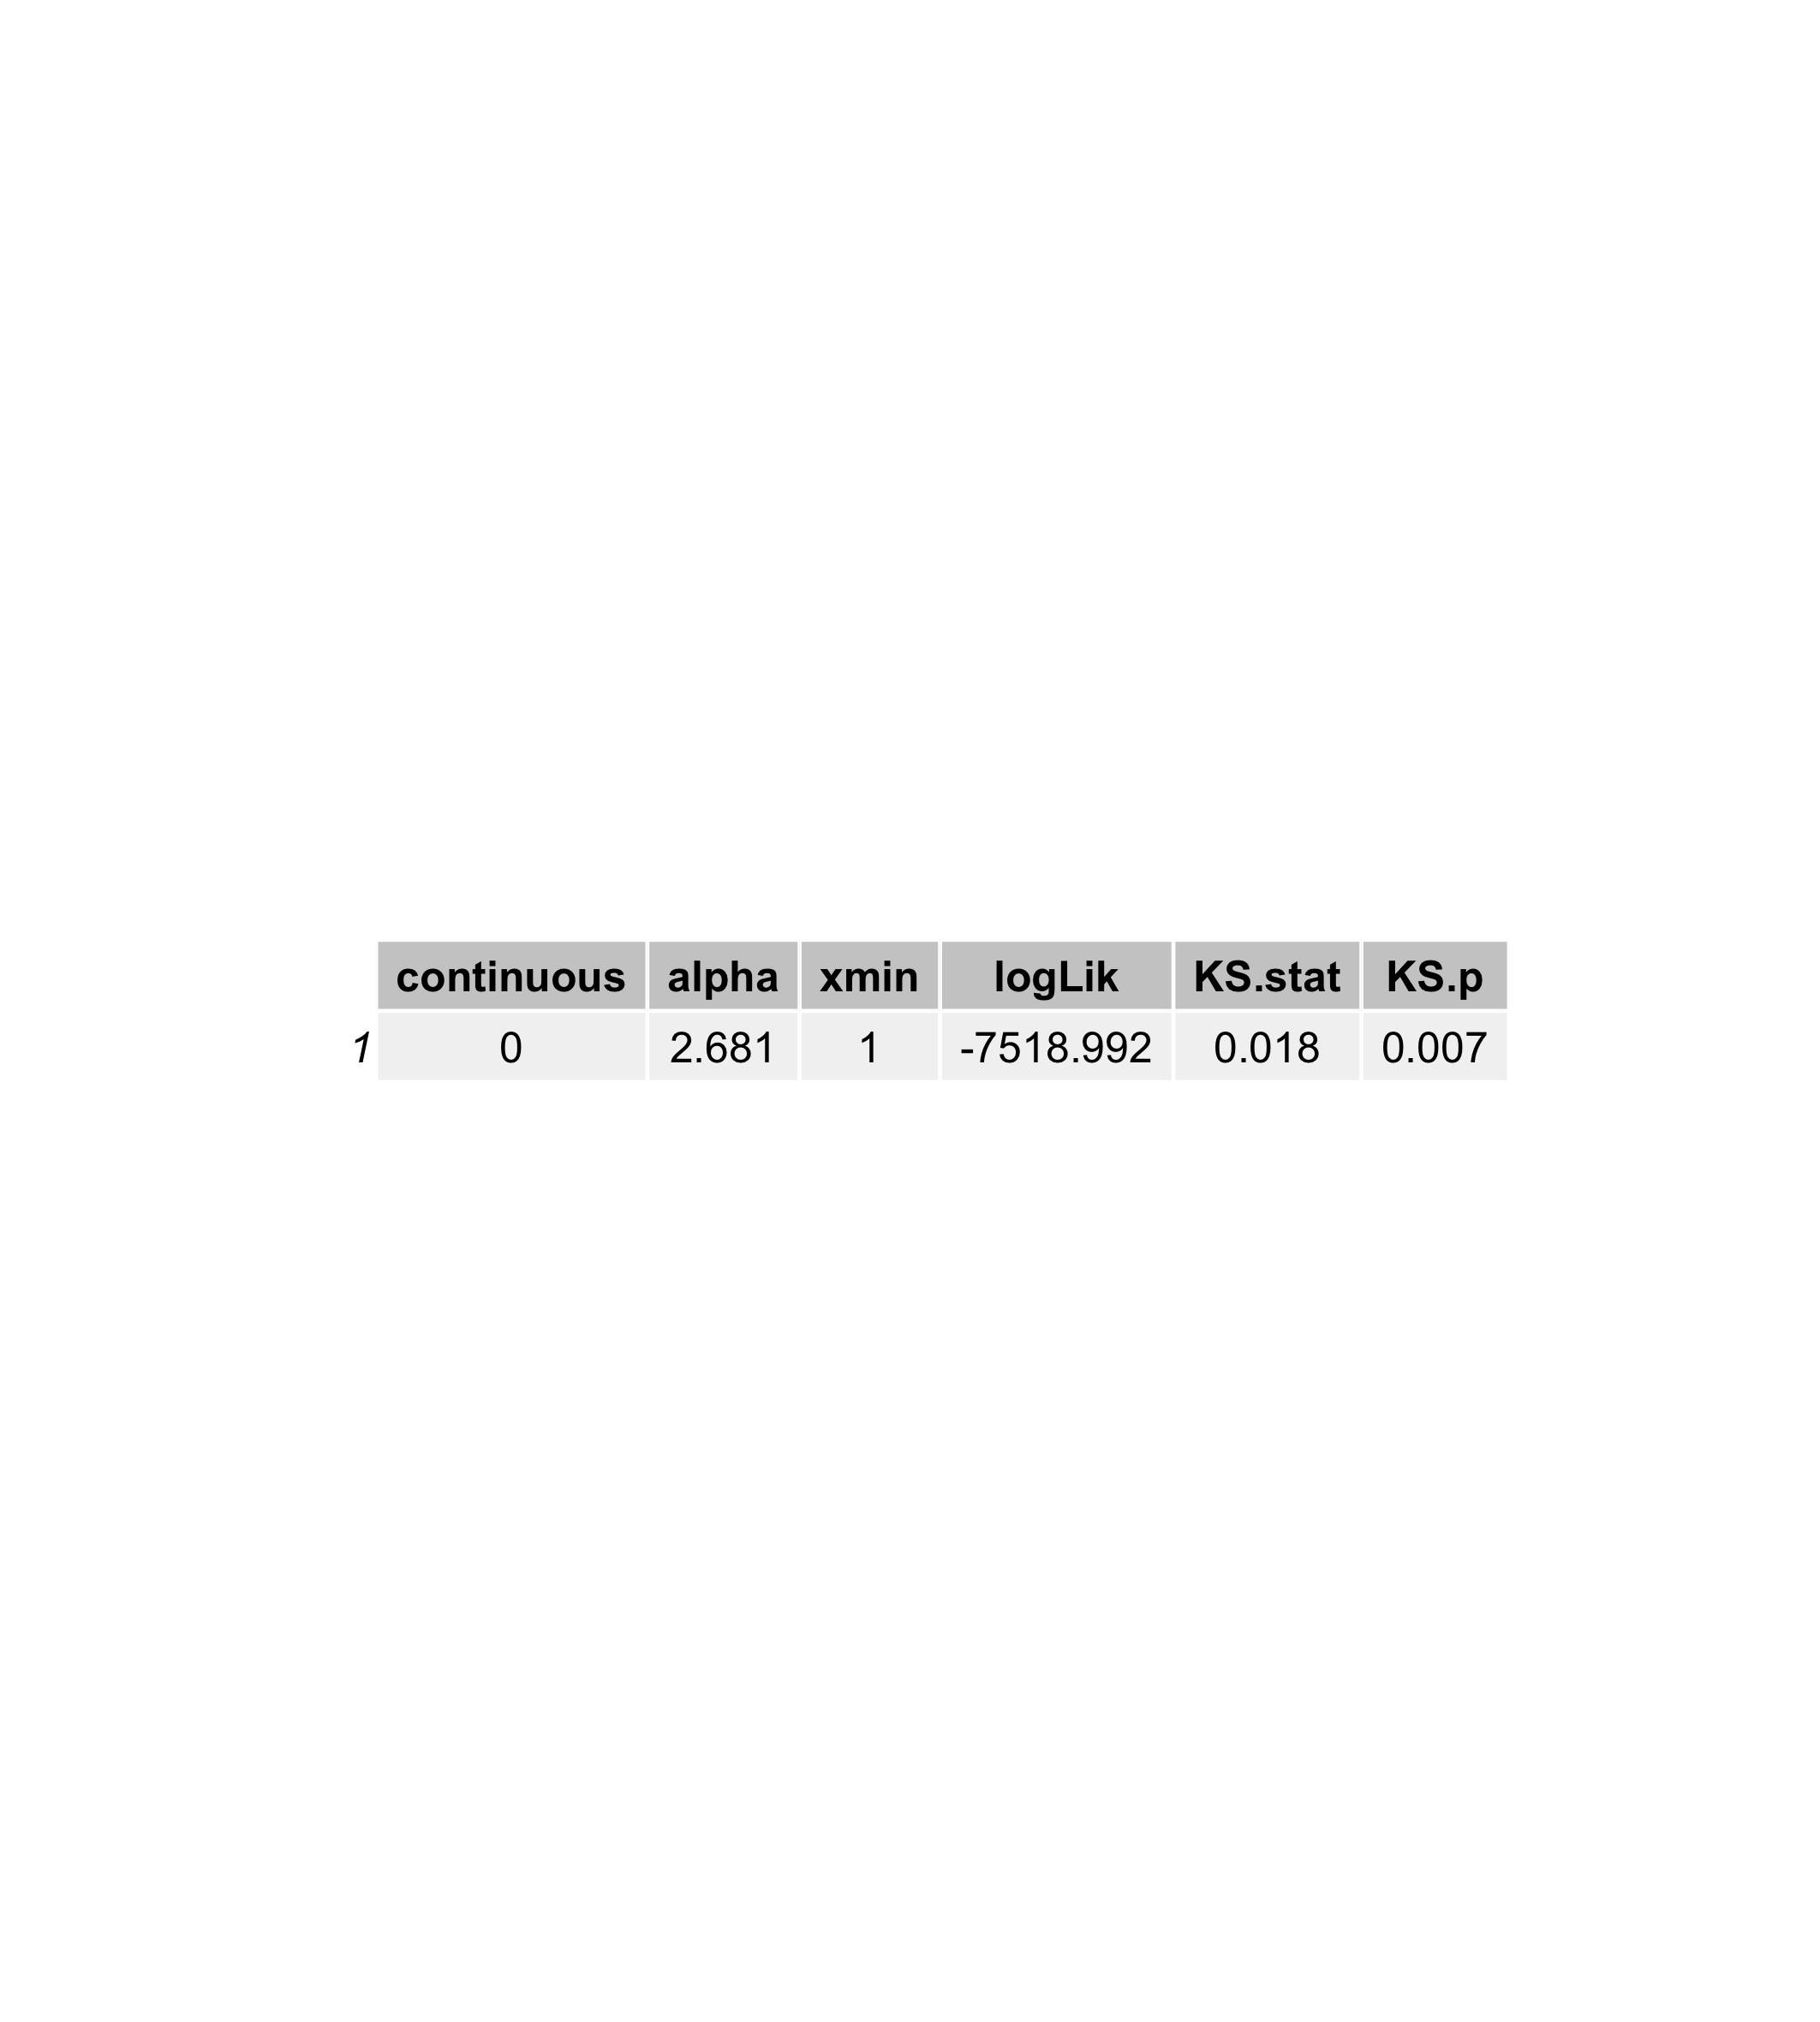

Slide 13

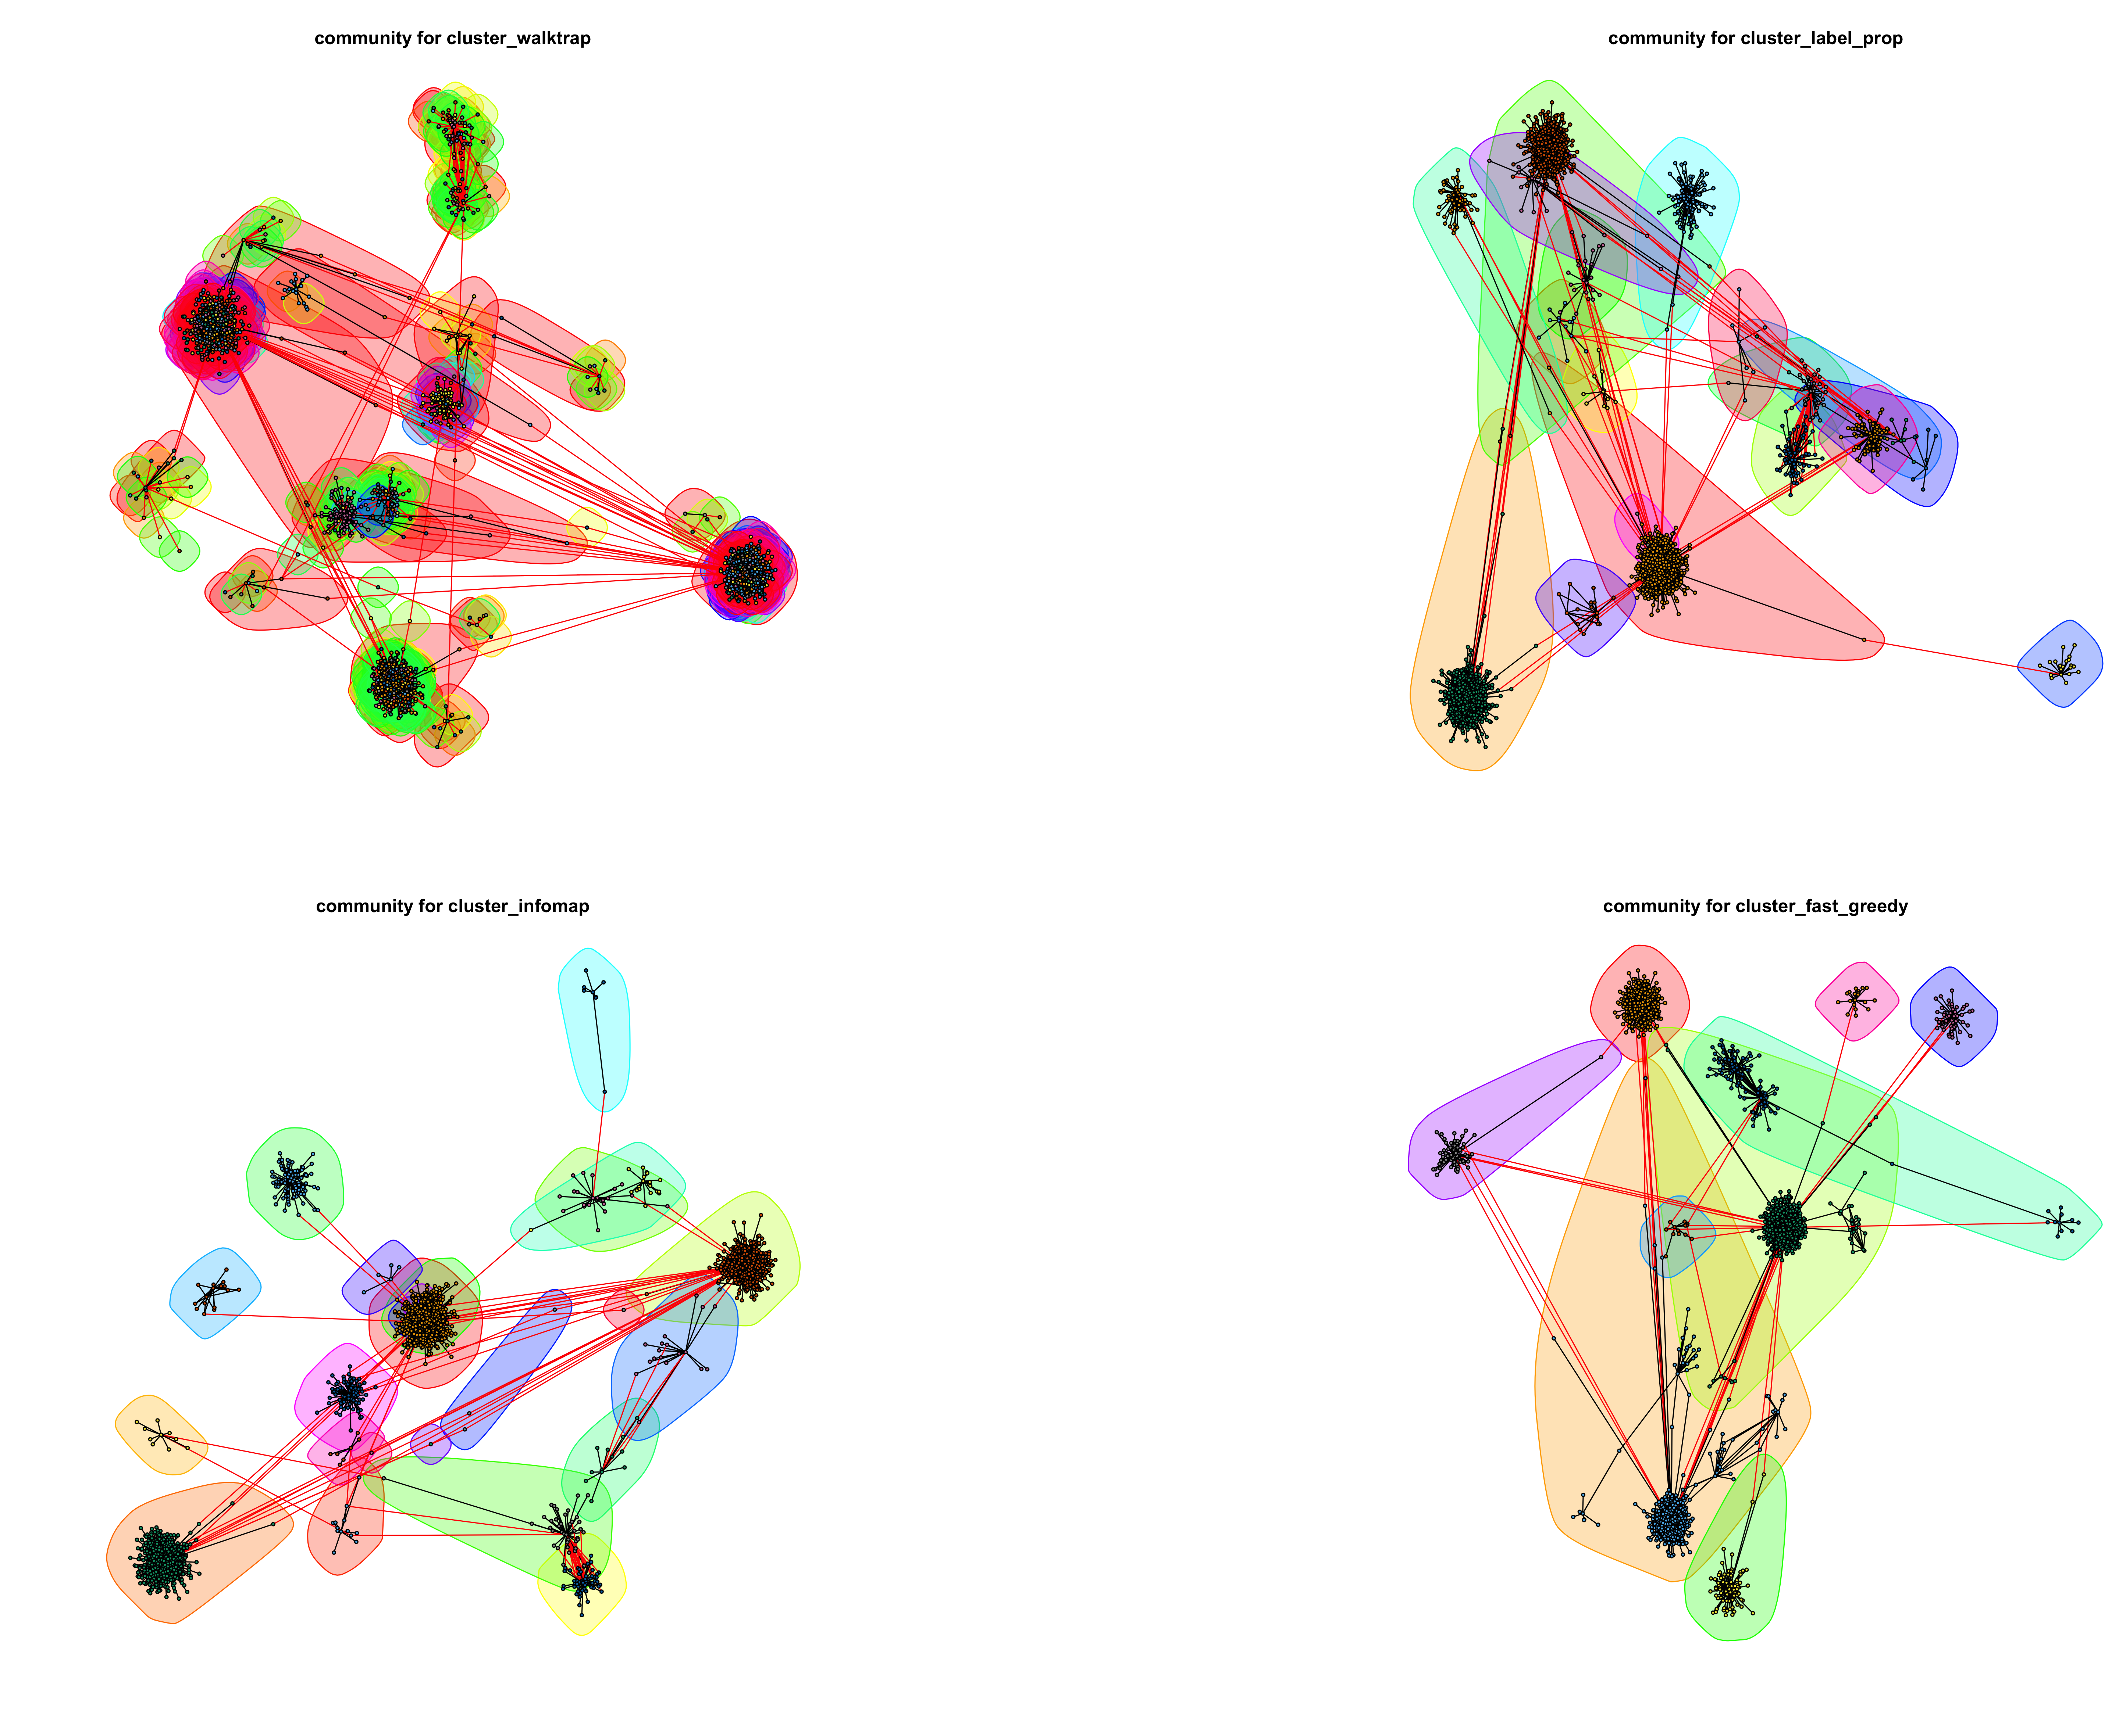

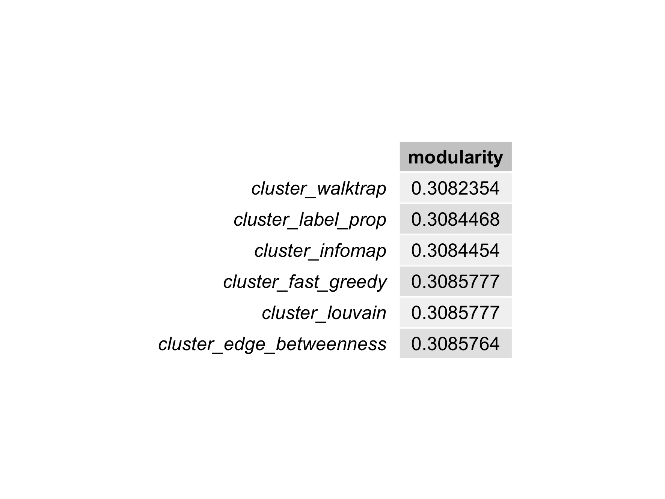



Modularity

Slide 14
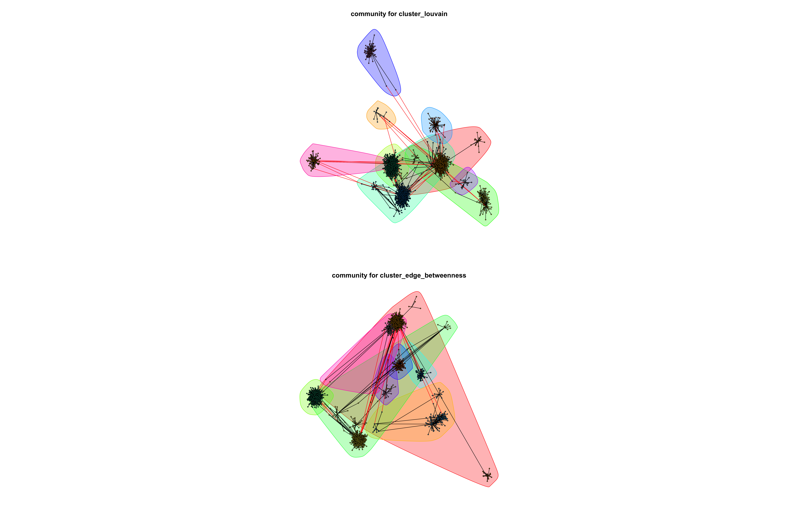
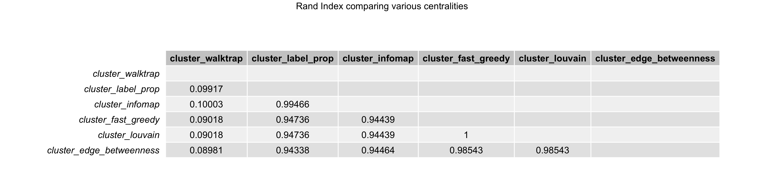
Centrality

Slide 15
Closeness

Slide 16
Jacquard & Vertex Proximity

Slide 17
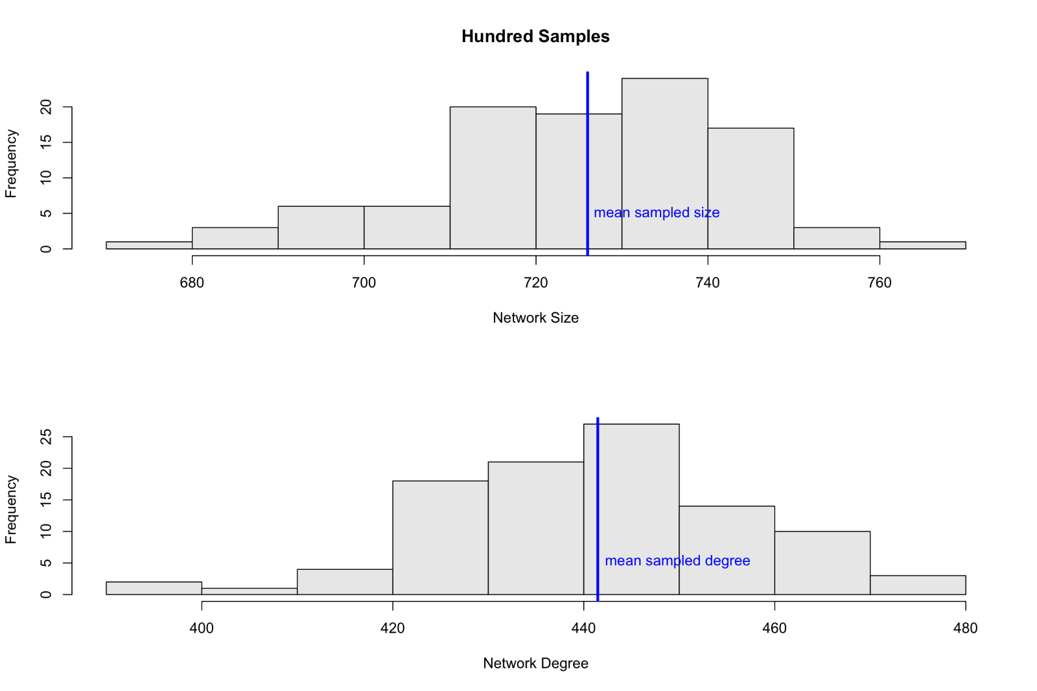
Approach B
Random Sample
10% Random sample ​
Size & Degree
Notes:
Monica

Slide 18
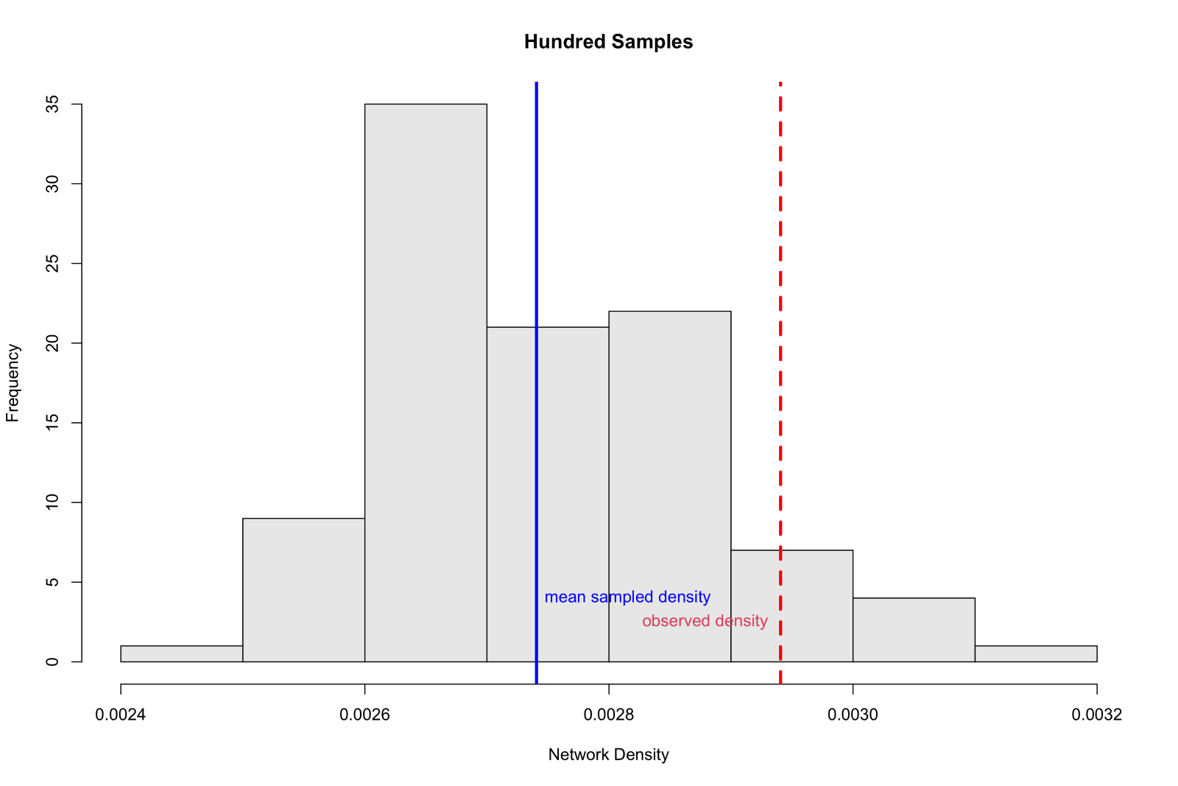
Density
Notes:
Monica

Slide 19
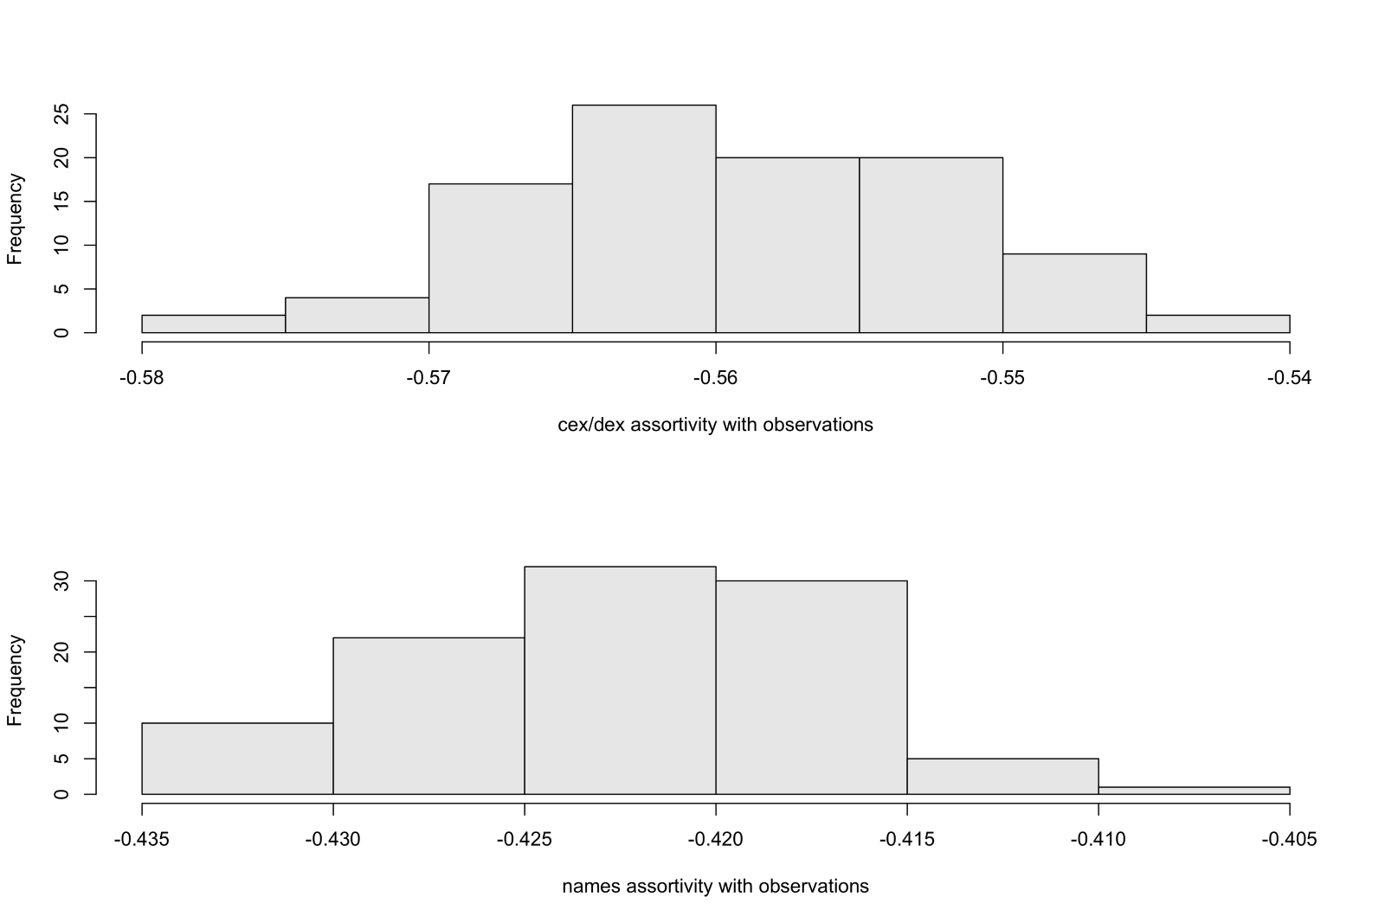
Assortativity
Notes:
Monica

Slide 20
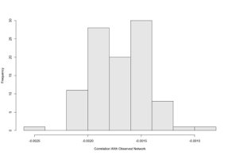
Correlation with other networks
Notes:
Monica

Slide 21
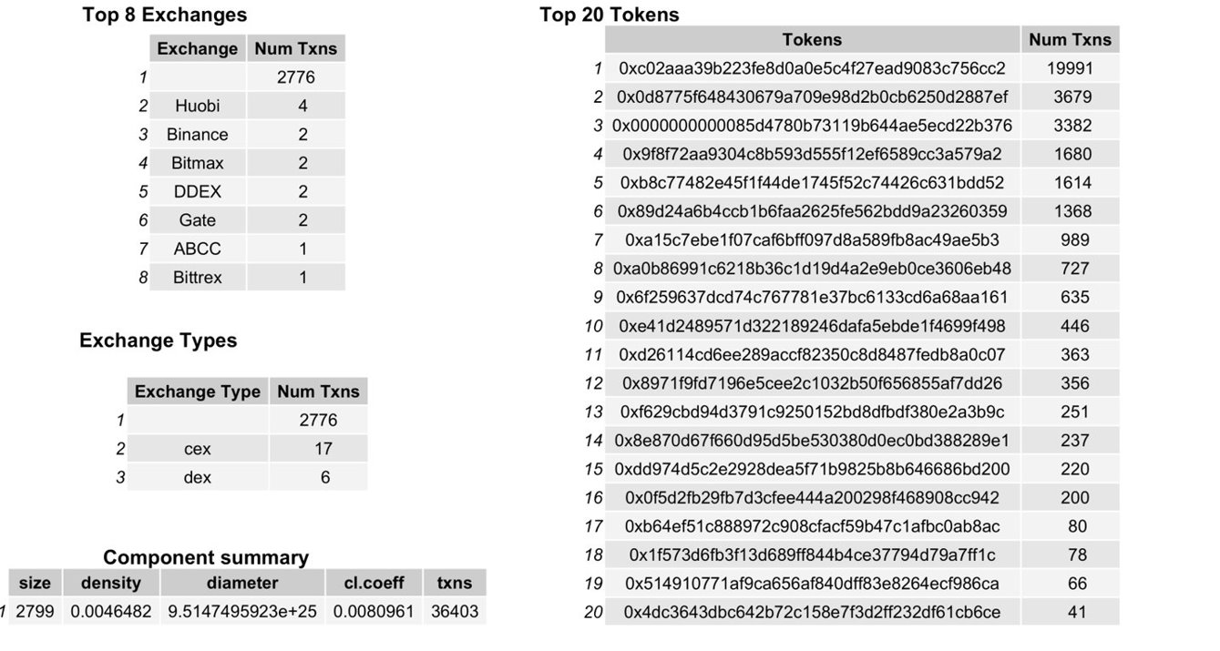
Model : Introduction
Modeling
Notes:
Monica

Slide 22
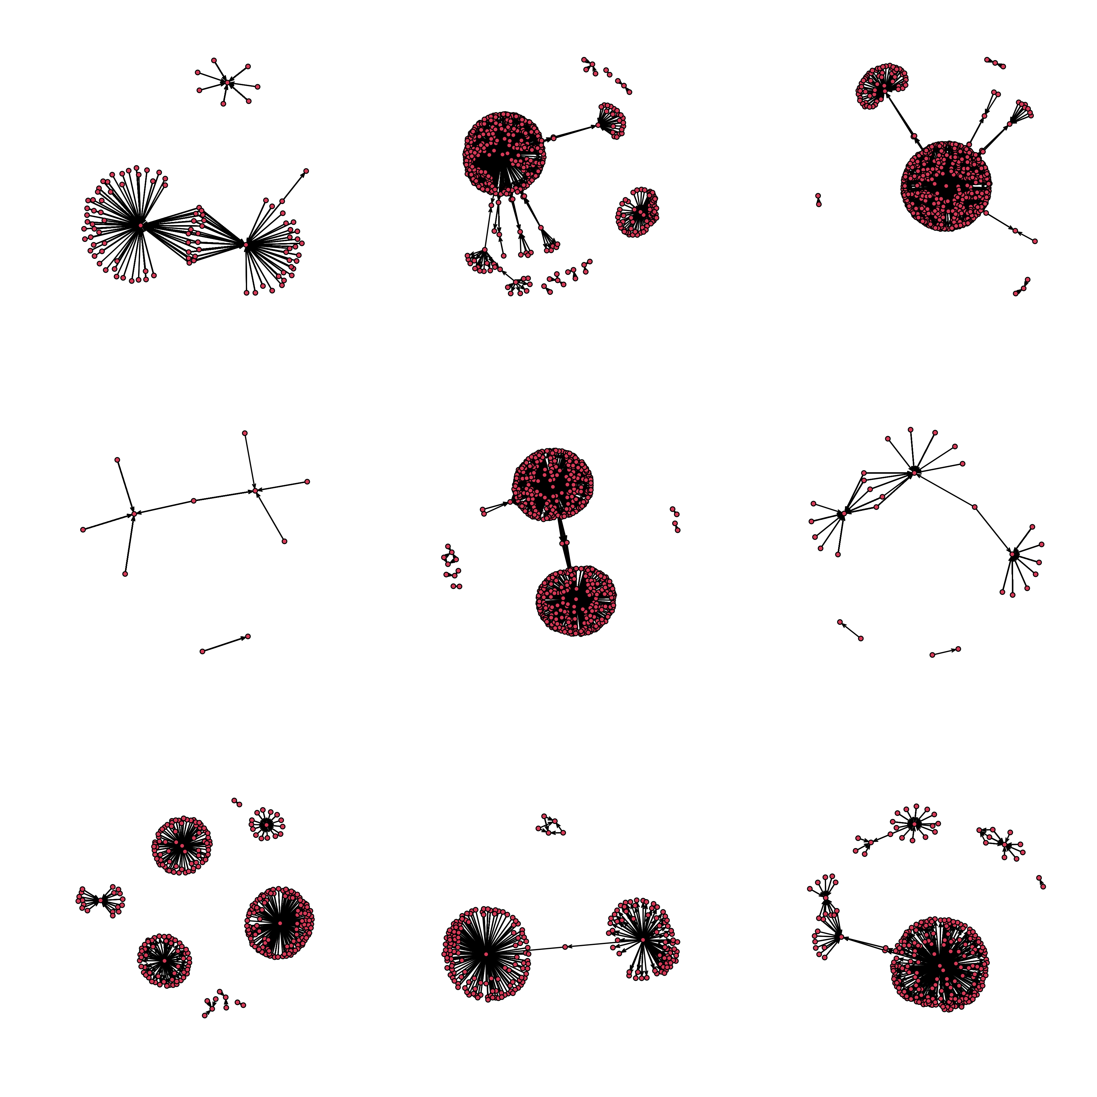
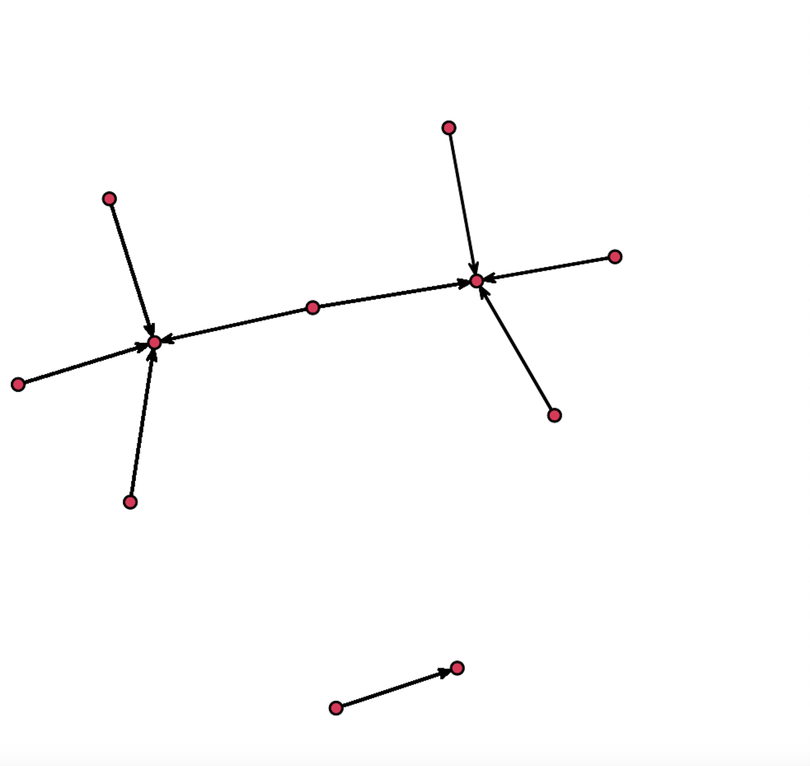
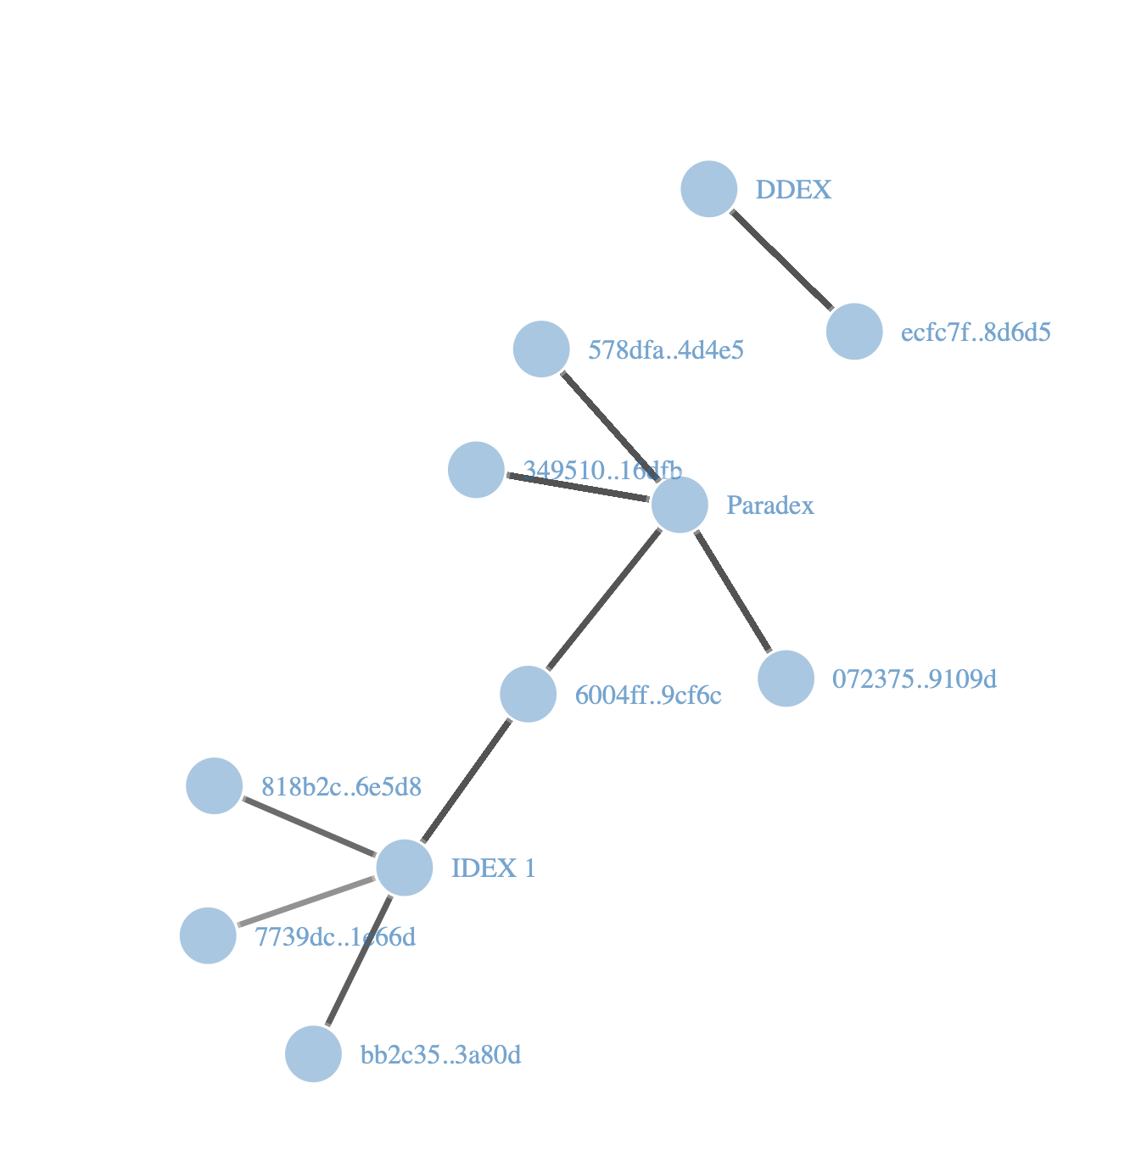
Top 9 Transaction:
Notes:
Monica

Slide 23
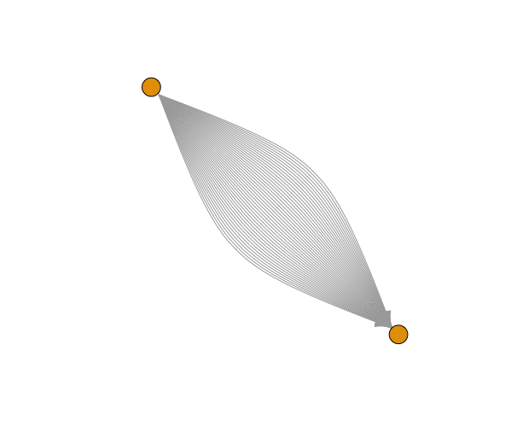
Heavy Flow model
Notes:
Monica

Slide 24
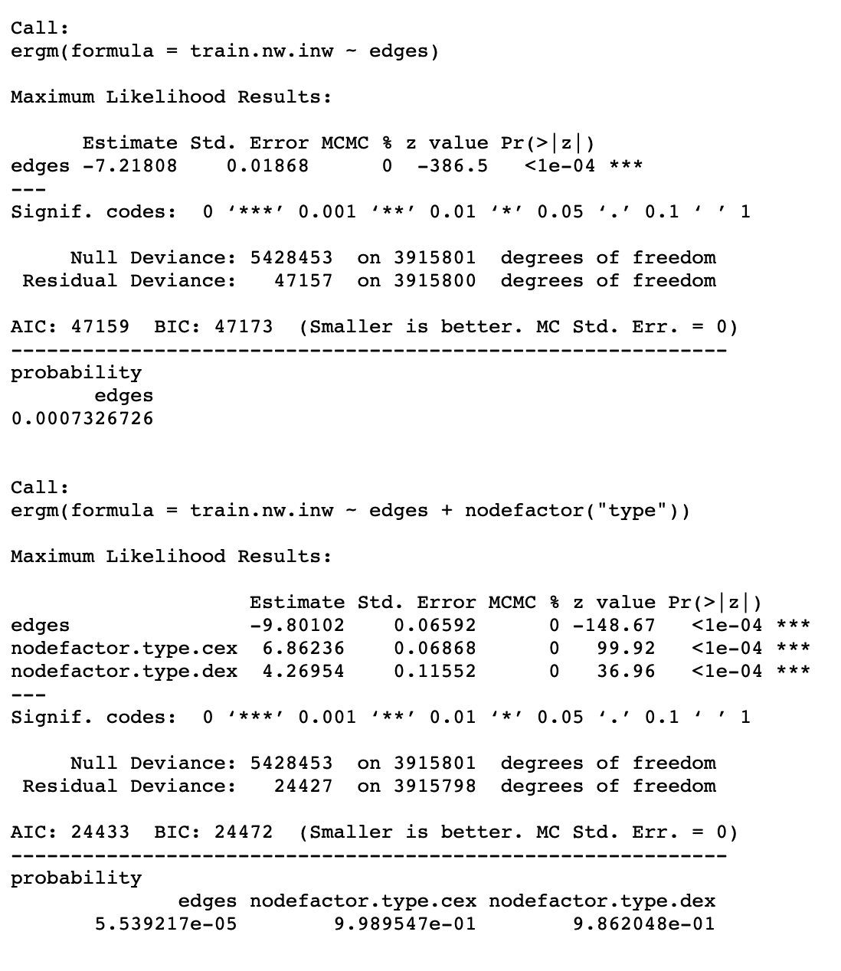
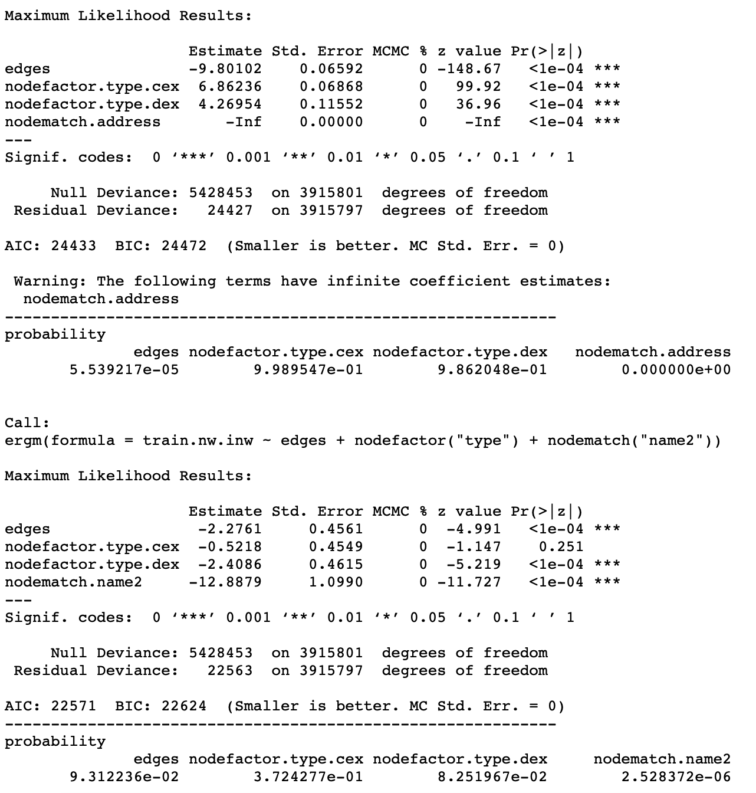
Base Model:
Notes:
Monica

Slide 25
QUESTIONS?
THANK YOU

